Slide 1

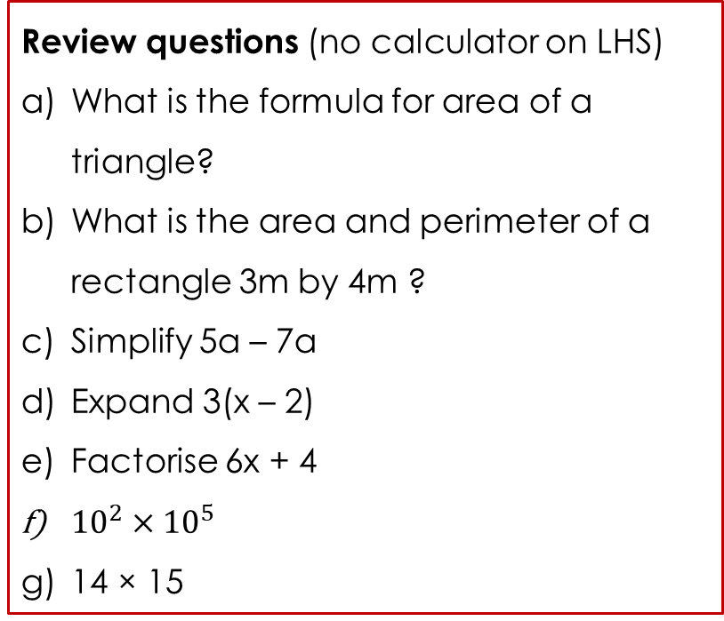
Topic: Probability EQ: What have we learnt about probability so far?
Review questions (no calculator on LHS)
What is the formula for area of a triangle?
What is the area and perimeter of a rectangle 3m by 4m ?
Simplify 5a – 7a
Expand 3(x – 2)
Factorise 6x + 4
${10}^{2}×{10}^{5}$
14 × 15
Steps to be successful this lesson:
Get materials out (notebook, pen, pencil, ruler, calculator)
Rule up notebook and write Topic and EQ
Start on review questions →
Check your answers with someone sitting next to you
Is your notebook up to date? (Contents page, glossary, review notes etc.)

Slide 2
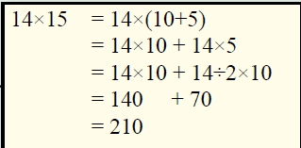
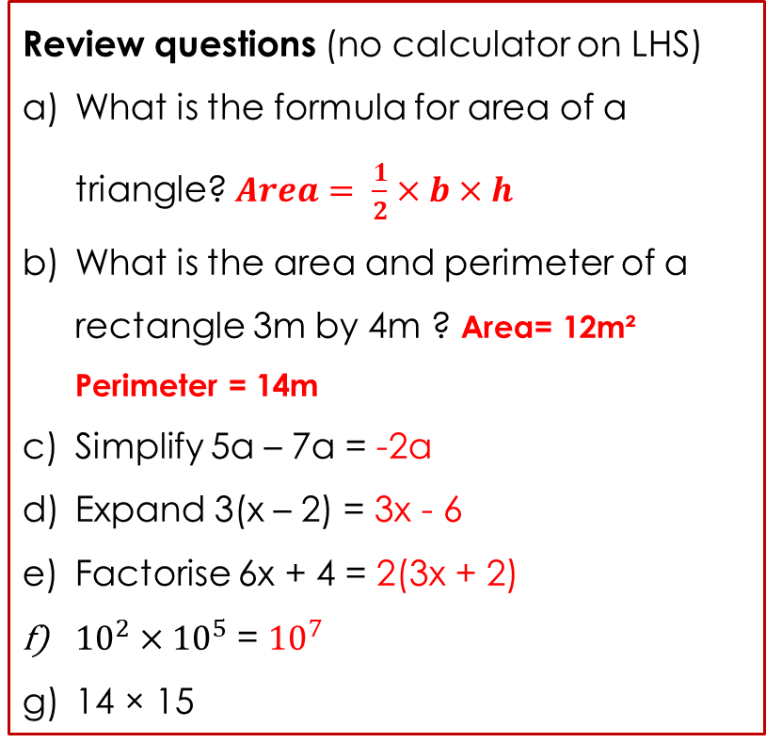
Topic: Probability EQ: What have we learnt about probability so far?
Review questions (no calculator on LHS)
What is the formula for area of a triangle? $Area= \frac{1}{2}×b×h$
What is the area and perimeter of a rectangle 3m by 4m ? Area= 12m² Perimeter = 14m
Simplify 5a – 7a = -2a
Expand 3(x – 2) = 3x - 6
Factorise 6x + 4 = 2(3x + 2)
${10}^{2}×{10}^{5}$ = ${10}^{7}$
14 × 15
Steps to be successful this lesson:
Get materials out (notebook, pen, pencil, ruler, calculator)
Rule up notebook and write Topic and EQ
Start on review questions →
Check your answers with someone sitting next to you
Is your notebook up to date? (Contents page, glossary, review notes etc.)

Slide 3
Probability review
Miss L (updated 2018 by Ms.Latham)
Year 9

Slide 4
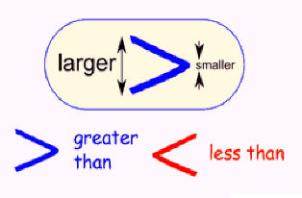
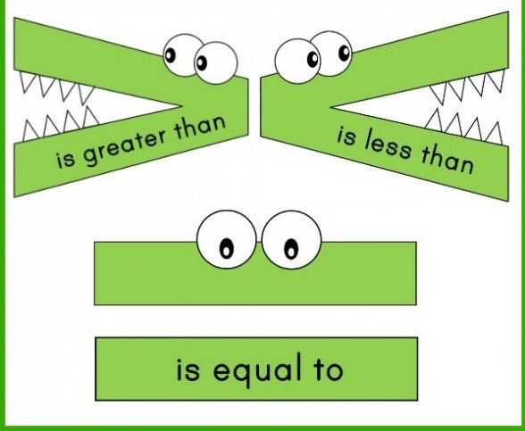
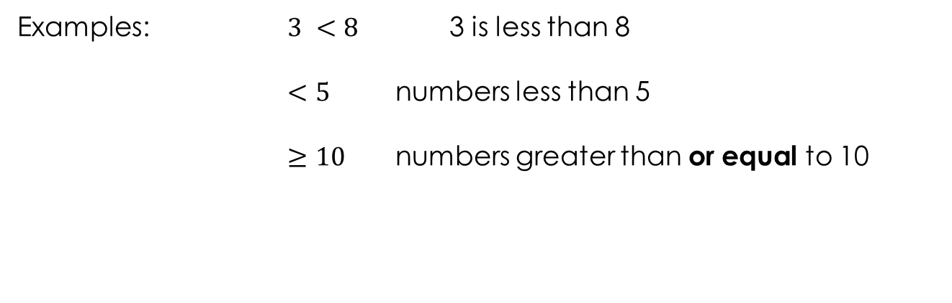
24
7
30
Topic: Probability
Date:
EQ – What have we learnt about probability so far?
Symbol Revision
Examples: $3 <8$ 3 is less than 8
$<5$ numbers less than 5
$≥10$ numbers greater than or equal to 10

Slide 5
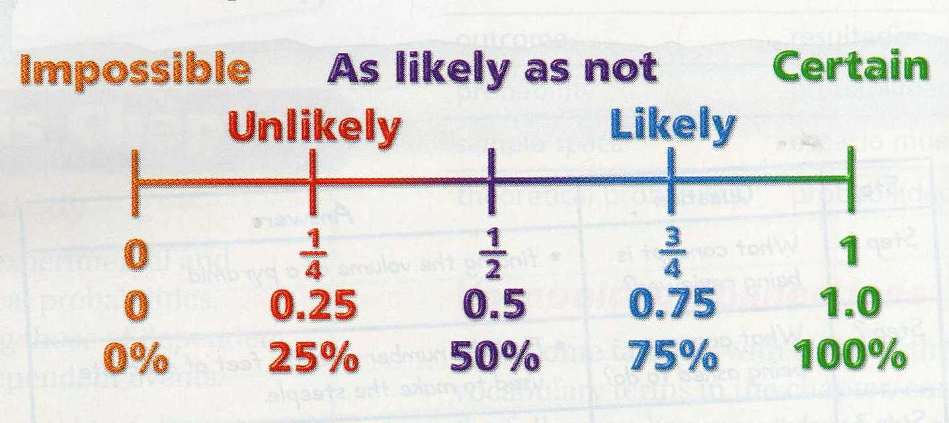
24
7
30
Topic: Probability
Date:
EQ – What have we learnt about probability so far?
Probability: is the likelihood that an event will occur.
Probability can be written as a fraction or decimal.
What is probability?
_______________
_______________
_______________

Slide 6
24
7
30
Topic: Probability
Date:
EQ – What have we learnt about probability so far?
Probability is always between 0 and 1.
Probability = 0 means that the event will NEVER happen.
Example: The probability that the Perth Wildcats will win the AFL Grand Final this year.
Probability = 1 means the event will ALWAYS happen.
Example: The probability that Christmas will be on December 25th next year.
What is probability?

Slide 7


Slide 8
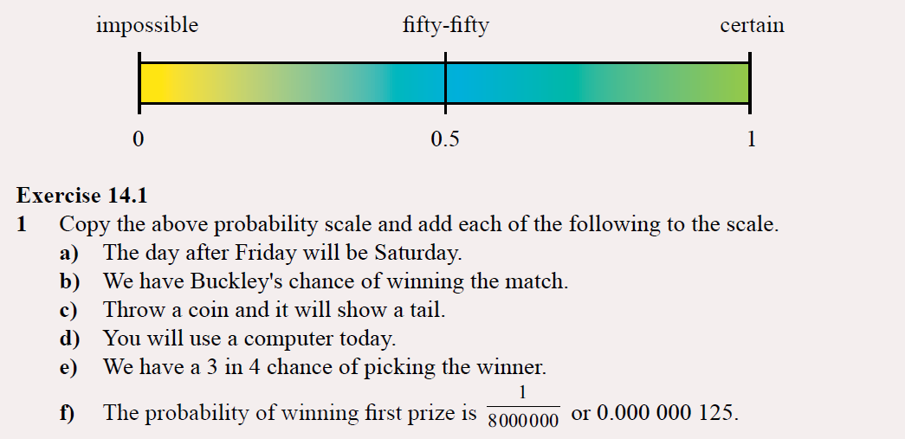
Practice
Notes:
Guide students through the question.
Option 2: Dot plots handout (Scaffolded for kids who may need extra help)

Slide 9
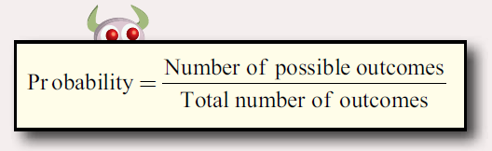
24
7
30
Topic: Probability
Date:
EQ – What have we learnt about probability so far?
How to calculate probability?

Slide 10
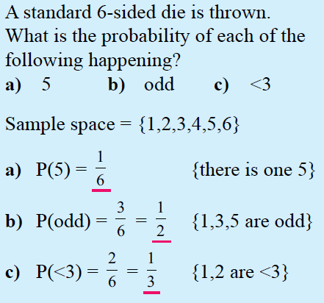
24
7
30
Topic: Probability
Date:
EQ – What have we learnt about probability so far?
Sample space: A list of all the possible outcomes.
How to calculate probability?

Slide 11
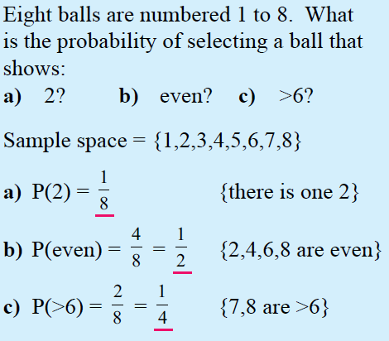
24
7
30
Topic: Probability
Date:
EQ – What have we learnt about probability so far?
Sample space: A list of all the possible outcomes.
How to calculate probability?

Slide 12
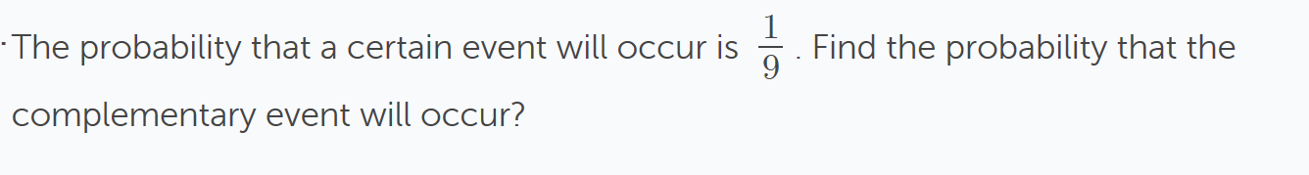
24
7
30
Topic: Probability
Date:
EQ – What have we learnt about probability so far?
Complement: means an event not happening.
Ex. The complement of having long hair is not having long hair.
What is complementary Probability?
The complement of event A is not event A which can be written as A’
Not A = A’
The sum of the probability of an event and its complete is 1
P(A) + P(A’) = 1
Therefore P(A’) = 1 - P(A)

Slide 13
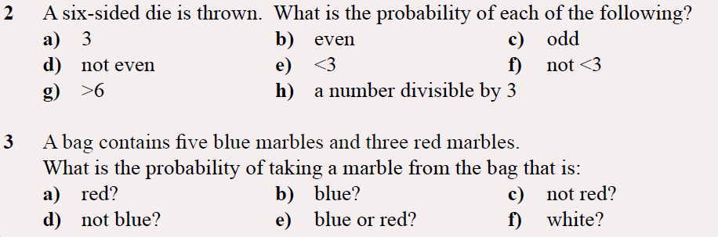
Task
Notes:
Guide students through the question.
Option 2: Dot plots handout (Scaffolded for kids who may need extra help)

